Slide 1
Working with Database

Slide 2
A database is an organized collection of structured information, or data, typically
stored electronically in a computer system. A database is usually controlled by a
database management system (DBMS). Together, the data and the DBMS, along with
the applications that are associated with them, are referred to as a database system.
Database systems are designed to manage large bodies of information. Management of data involves both defining structures for storage of information and providing mechanisms for the manipulation of information. In addition, the database system must ensure the safety of the information stored, despite system crashes or attempts at unauthorized access.
Data within the most common types of databases in operation today is typically modeled in rows and columns in a series of tables to make processing and data querying efficient. The data can then be easily accessed, managed, modified, updated, controlled, and organized. Most databases use structured query language (SQL) for writing and querying data.
There are many database management systems available like SQL Server, MySQL, Oracle, MongoDB, PostgreSQL etc.

Slide 3
SQL Server
SQL SERVER is a relational database management system (RDBMS) developed
and maintained by Microsoft. As a database server, it is a software product with the primary function of storing and retrieving data as requested by other software applications, which may run either on the same computer or on another computer across a network (including the Internet).
Similar to other RDBMS software, SQL Server is built on top of SQL, a standard programming language for interacting with the relational databases. SQL server is tied to Transact-SQL, or T-SQL, the Microsoft’s implementation of SQL that adds a set of proprietary programming constructs.
SQL Server works exclusively on Windows environment for more than 20 years. In 2016, Microsoft made it available on Linux. SQL Server 2017 became generally available in October 2016 that ran on both Windows and Linux.

Slide 4
ADO.NET basics
ADO.NET is a data access technology from the Microsoft .NET Framework that provides communication between relational and non-relational systems through a common set of components. It is a part of the base class library that is included with the Microsoft .NET Framework. Data sources can be such as SQL Server and XML. ADO.NET consists of classes that can be used to connect, retrieve, insert and delete data.
The following are a few of the .NET applications that use ADO.NET to connect to a database, execute commands and retrieve data from the database.
ASP.NET Web Applications
Console Applications
Windows Applications

Slide 5
Various Connection Architectures
There are the following two types of connection architectures:
Connected architecture:
The application remains connected with the database throughout the processing.
Disconnected architecture:
The application automatically connects/disconnects during the processing. The application uses temporary data on the application side called a DataSet.

Slide 6
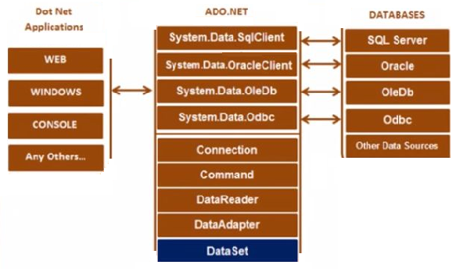
Understanding ADO.NET and its class library
In the diagram above, there are various types of applications (Web Application, Console Application, Windows Application and so on) that use ADO.NET to connect various databases (SQL Server, Oracle, OleDb, ODBC, XML files and so on)

Slide 7
Important Classes in ADO.NET
1. Connection Class:
It is used to establish an open connection to the database. It is a sealed class so that cannot be inherited. When the connection of an object is instantiated, the constructor takes a connection string that contains the information about the database server, server type, database name, connection type, and database user credentials. Once the connection string is passed and the connection object is created, you can establish a connection with the database. A connection string is usually stored in the web.config file or app.config file of an application.

Slide 8
2) Command Class:
The Command class provides methods for storing and executing SQL statements and
Stored Procedures. The following are the various commands that are executed by the
Command Class.
ExecuteReader: Returns data to the client as rows. This would typically be an SQL
select statement or a Stored Procedure that contains one or more select statements.
This method returns a DataReader object that can be used to fill a DataTable object or
used directly for printing reports and so forth.
ExecuteNonQuery: Executes a command that changes the data in the database, such
as an update, delete, or insert statement, or a Stored Procedure that contains one or
more of these statements. This method returns an integer that is the number of rows
affected by the query.
ExecuteScalar: This method only returns a single value. This kind of query returns a
count of rows or a calculated value.
ExecuteXMLReader: (SqlClient classes only) Obtains data from an SQL Server 2000 database using an XML stream. Returns an XML Reader object.

Slide 9
3. DataReader Class
The DataReader is used to retrieve data. It is used in conjunction with the Command class to execute an SQL Select statement and then access the returned rows.
4. DataAdapter Class
The DataAdapter is used to connect DataSets to databases. The DataAdapter is most useful when using data-bound controls in Windows Forms, but it can also be used to provide an easy way to manage the connection between your application and the underlying database tables, views and Stored Procedures.
5. DataSet Class
The DataSet is the heart of ADO.NET. The DataSet is essentially a collection of DataTable objects. In turn each object contains a collection of DataColumn and DataRow objects. The DataSet also contains a Relations collection that can be used to define relations among Data Table Objects.

Slide 10
Connect to a Database using ADO.NET
To create a connection, you must be familiar with connection strings. A connection
string is required as a parameter to SQLConnection. A ConnectionString is a string
variable (not case sensitive).
This contains key and value pairs, like provider, server, database, userid and word as in the
following:
Server = "nameof the server or IP Address of the server"
Database="name of the database"
Userid ="user name who has permission to work with database"
Password="the password of userid“
Example
SQL Authentication
String constr="server=.;database=demostore;user id=root;password=Pass@123";
Or:
String constr="data source=.;initial catalog=demostore;uid=root;pwd=Pass@213";
Windows Authentication
String constr="server=.;database=demostore;trusted_connection=true"
Or:
String constr="server=.;initial catalog=demostore;integrated security=true"

Slide 11
Steps to retrieve and display data from a database
Create a SqlConnection object using a connection string.
Handle exceptions.
Open the connection.
Create a SQLCommand. To represent a SQLCommand like (select * from studentdetails) and attach the existing connection to it. Specify the type of SQLCommand (text/storedprocedure).
Execute the command (use executereader).
Get the Result (use SqlDataReader). This is a forwardonly/readonly dataobject.
Close the connection
Process the result
Display the Result

Slide 12
ADO.NET SqlConnection Class
It is used to establish an open connection to the SQL Server database. It is
a sealed class so that cannot be inherited. Connection does not get
closed explicitly even it goes out of scope. Therefore, you must explicitly
close the connection by calling Close() method.
SqlConnection Constructors
SqlConnection()
SqlConnection(String)
SqlConnection(String, SqlCredential)
SqlConnection Methods
Open(),BeginTransaction(),ChangeDatabase(String),Close()

Slide 13
using System.Data.SqlClient
using (SqlConnection connection = new SqlConnection(connectionString))
{
connection.Open();
}
Using block is used to close the connection automatically. You don't need to call close () method explicitly, using block do this implicitly when the code exits the block.

Slide 14
ADO.NET SqlCommand Class
The SqlCommand class is at the heart of the System.SqlClient namespace. It is used to
execute operations on a database and retrieve data.
SqlCommand Constructors
SqlCommand(), SqlCommand(String),
SqlCommand(String, SqlConnection),
SqlCommand(String, SqlConnection, SqlTransaction)
SqlCommand Methods
Cancel() > Cancels the running query
CreateParameter() > Returns a new SQL parameter
ExecuteNonQuery() > Executes the query against the database and does not return
a result set
ExecuteReader() > Executes the query and returns data in a DataReader object
ExecuteScalar() > Executes the query and returns a single value
ExecuteXmlReader() > Executes the query and returns data in an
XMLDataReader object
ResetCommandTimeout() > Resets the CommandTimeout property for the query

Slide 15
// Creating Connection
SqlConnection con = new SqlConnection("data source=.; database=studentdb; integrated security=True");
// Opening Connection
con.Open();
// writing sql query
SqlCommand cm = new SqlCommand("select * from student", con);
// Executing the SQL query
SqlDataReader sdr = cm.ExecuteReader();
while (sdr.Read())
{
Console.WriteLine(sdr["name"]+" "+ sdr["email"]);
}
//Closing Connection
Con.Close()

Slide 16
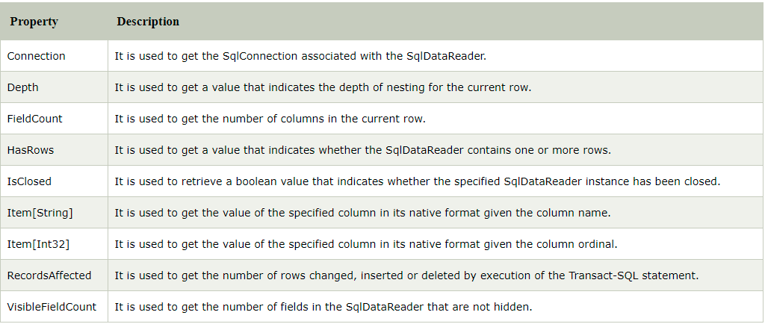
ADO.NET SqlDataReader Class
The SqlDataReader class defines a lightweight yet powerful object that is used to read information from a SQL database. It doesn't contain more than a single record in memory at any time. This makes it ideal for reading large amounts of data from a database.

Slide 17
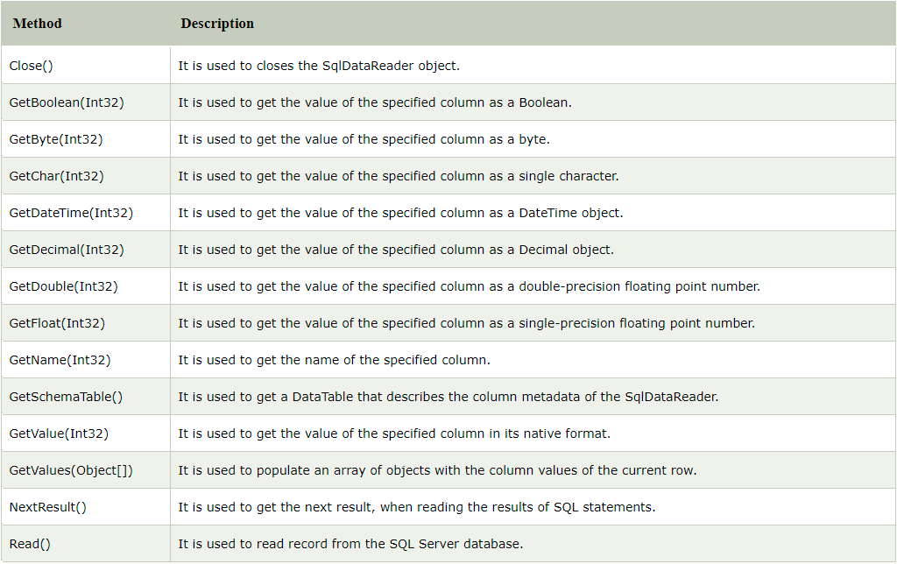

Slide 18
SqlCommand cmd = new SqlCommand("select * from students", conn);
//Execute reader
SqlDataReader reader = cmd.ExecuteReader();
while(reader.Read()){
Console.WriteLine(reader[“name”]);
}

Slide 19
ADO.NET DataSet
It is a collection of data tables that contain the data. It is used to fetch data without interacting with a Data Source that's why, it also known as disconnected data access method. It is an in-memory data store that can hold more than one table at the same time. We can use DataRelation object to relate these tables. The DataSet can also be used to read and write data as XML document.
ADO.NET provides a DataSet class that can be used to create DataSet object. It contains constructors and methods to perform data related operations.

Slide 20
ADO.NET DataAdapter
The DataAdapter works as a bridge between a DataSet and a data source to retrieve data. DataAdapter is a class that represents a set of SQL commands and a database connection. It can be used to fill the DataSet and update the data source.
using (SqlConnection con = new SqlConnection("data source=.; database=student; integrated security=true"))
{
SqlDataAdapter sde = new SqlDataAdapter("Select * from student", con);
DataSet ds = new DataSet();
sde.Fill(ds);
GridView1.DataSource = ds;
GridView1.DataBind();
}

Slide 21
You can use the ADO.NET DataReader to retrieve a read-only, forward-only stream of data from a database. Results are returned as the query executes, and are stored in the network buffer on the client until you request them using the Read method of the DataReader. Using the DataReader can increase application performance both by retrieving data as soon as it is available, and (by default) storing only one row at a time in memory, reducing system overhead. it is a read and forward only connection oriented architecture during fetch the data from database. DataReader will fetch the data very fast when compared with dataset. Generally we will use ExecuteReader object to bind data to datareader.
DataSet is a disconnected orient architecture that means there is no need of active connections during work with datasets and it is a collection of DataTables and relations between tables. It is used to hold multiple tables with data. You can select data form tables, create views based on table and ask child rows over relations. Also DataSet provides you with rich features like saving data as XML and loading XML data.
A DataAdapter is used to retrieve data from a data source and populate tables within a DataSet. The DataAdapter also resolves changes made to the DataSet back to the data source. The DataAdapter uses the Connection object of the .NET Framework data provider to connect to a data source, and it uses Command objects to retrieve data from and resolve changes to the data source.

Slide 22
ADO.NET DataTable
DataTable represents relational data into tabular form. ADO.NET provides a DataTable class to create and use data table independently. It can also be used with DataSet also. Initially, when we create DataTable, it does not have table schema. We can create table schema by adding columns and constraints to the table. After defining table schema, we can add rows to the table.
We must include System.Data namespace before creating DataTable.
DataTable table = new DataTable();
table.Columns.Add("ID");
table.Columns.Add("Name");
table.Columns.Add("Email");
table.Rows.Add("101", "john","john@example.com");
table.Rows.Add("102", "Tina", "tina@example.com");
table.Rows.Add("103", "Ray", "ray@example.com");
GridView1.DataSource = table;
GridView1.DataBind();

Slide 23
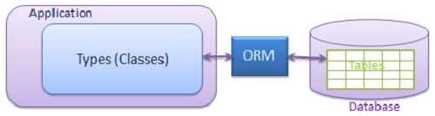
Object Relational Mapper
An object-relational mapper (ORM) is a code library that automates the conversion of
data stored in relational database tables into objects that are more commonly used in
application code. Object Relational Mapping (ORM) is a programming technique that
allows you to query and manipulate data stored in a relational database using an
object-oriented approach instead of writing SQL statements.

Slide 24
In addition to the data access technique, ORM's benefits also include:
Simplified development because it automates object-to-table and table-to-object conversion, resulting in lower development and maintenance costs
Less code compared to embedded SQL and handwritten stored procedures
Transparent object caching in the application tier, improving system performance
An optimized solution making an application faster and easier to maintain
ORM products that supported by ASP.NET Core MVC :
NHibernate,
Dapper
Entity Framework

Slide 25
Entity Framework Core (EF Core)
Entity Framework Core is an open-source, lightweight, extensible and a cross-platform
version of Entity Framework data access technology.Entity Framework is an Object
Relational Mapping (ORM) framework. It is an enhancement to ADO.NET that gives
developers an automated mechanism for accessing & storing the data in the database.
EF Core is intended to be used with .NET Core applications. However, it can also be
used with standard .NET 4.5+ framework based applications.
Entity Framework also provides services like change tracking, identity resolution, lazy loading, and query translation so that developers can focus on their application-specific business logic rather than the data access fundamentals.
EF Core Supported Application Types
1. Console Applications
2. Windows Applications
3. ASP.NET Web Forms
4. ASP.NET MVC
5. ASP.NET MVC Core
6. WPF
7. Xamarin Framework.
8. Web API

Slide 26
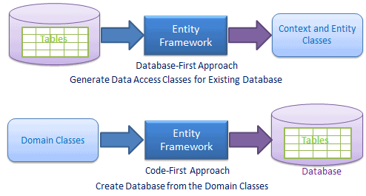
EF Core Development Approaches
EF Core supports two development approaches 1) Code-First 2) Database-First
In the code-first approach, EF Core API creates the database and tables using migration based on the conventions and configuration provided in your domain classes. This approach is useful in Domain Driven Design (DDD).
In the database-first approach, EF Core API creates the domain and context classes
based on your existing database using EF Core commands.

Slide 27
Entity Framework Core Features
Some important features of EF Core are:
1. DbContext & DbSet
2. LINQ Support
3. Tracking
4. Migrations
5. Batch Insert, Update and Delete operations
Supported Databases
Entity Framework Core works on many databases like:
1. SQL Server
2. MySQL
3. PostgreSQL
4. SQLite
5. SQL Compact
6. Firebird
7. Oracle
8. Db2

Slide 28
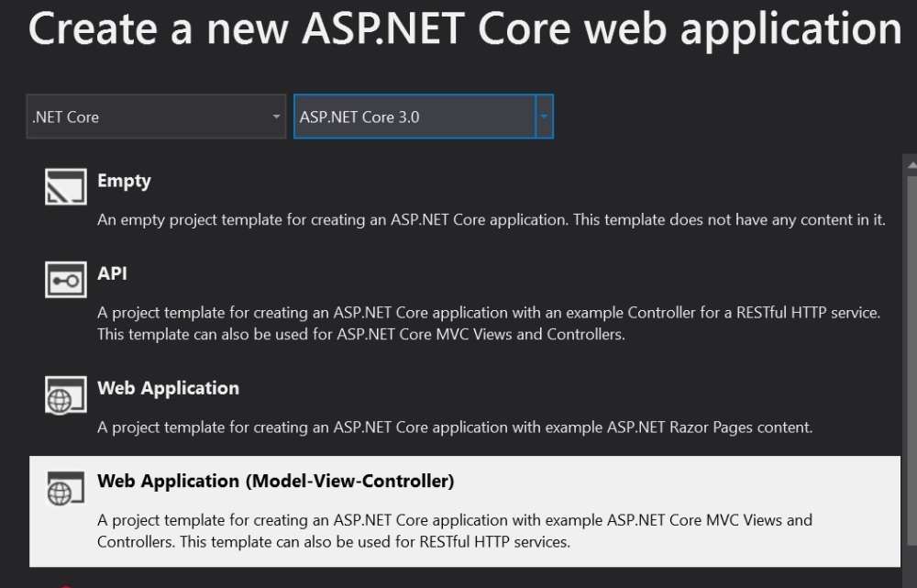
Adding EF Core to an Application

Slide 29
Install the required NuGet packages
Microsoft.VisualStudio.Web.CodeGeneration.Design is used for generating controllers and views.
Microsoft.EntityFrameworkCore.Tools is used for creating database context and a model class from the database.
Microsoft.EntityFrameworkCore.SqlServer is used for communicating the sql server database using Entity-framework.
NuGet: NuGet is a package manager for developers. It enables developers to share and consume useful code. An essential mechanism through which developers can create, share, and consume useful code. Often such code is bundled into "packages" that contain compiled code (as DLLs) along with other content needed in the projects that consume these packages.

Slide 30
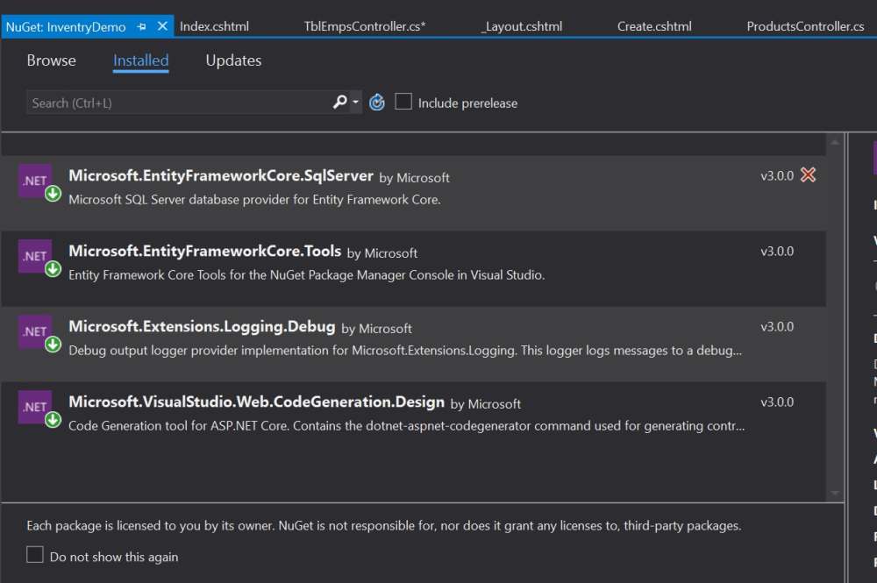

Slide 31
SQL Connection Configuration
SQL Server DB connection configuration defined in appsettings.json.
Connection string could be also be stored in an environment variable or Config Server
or Secrete storage if any available.
{
"Logging": {
"LogLevel": {
"Default": "Information",
"Microsoft": "Warning",
"Microsoft.Hosting.Lifetime": "Information"
}
},
"AllowedHosts": "*",
"ConnectionStrings": {
"DemoStore": "Server=.\\;Database=DemoStore;Integrated Security=True"
}
}

Slide 32
Update ConfigureServices for DBContext
ConfigureServices at Startup.cs
services.AddDbContext<DemoStoreContext>(options =>
{ options.UseSqlServer(
Configuration.GetConnectionString("DemoStore"));
}
);

Slide 33
DB Context The DbContext class is an integral part of Entity Framework. An instance of DbContext represents a session with the database which can be used to query and save instances of your entities to a database.
public class DemoStoreContext : DbContext
{
protected override void OnConfiguring(DbContextOptionsBuilder optionsBuilder)
{
}
protected override void OnModelCreating(ModelBuilder modelBuilder)
{
}
//entities
public DbSet<Category> Categories { get; set; }
public DbSet<Product> Products { get; set; }
}

Slide 34
DbContext in EF Core allows to perform following tasks:
Manage database connection
Configure model & relationship
Querying database
Saving data to the database
Configure change tracking
Caching
Transaction management

